Slide 1
Compare and Contrast
Real-World Examples
Created By: Jeffrey A. Shaffer Vice President, Unifund Adjunct Faculty, University of Cincinnati (513) 615-0001 | JeffreyShaffer@gmail.com @HighVizAbility
Notes:
Title Slide

Slide 2
Goals
By completing the course modules, students will:
Compare and contrast real-world examples
Explore redesigns to improve the visualization of the data
Understand various issues encountered with certain chart types

Slide 3
Compare and Contrast
Real-World Examples

Slide 4
Real-World Example
Fox News

Slide 5
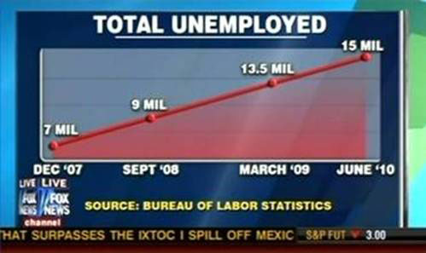
Notes:
This example comes from Fox News. They are showing the total unemployment from December 2008 through June 2010. What’s the problem with this chart?
[class discussion – the issue is the time scale which is not equal, therefore this isn’t a straight line]

Slide 6
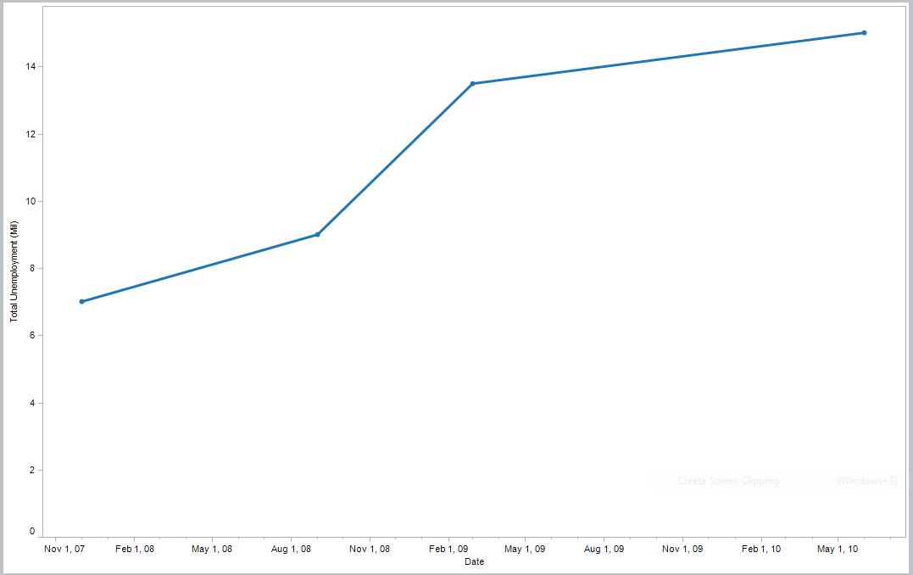
Notes:
This is the actual data plotted on the correct time scale. There is a big uptick in the unemployment rate during the peak of the recession. This shows a bit of different trend vs. the straight line that fox news was showing.

Slide 7
Compare & Contrast

Slide 8
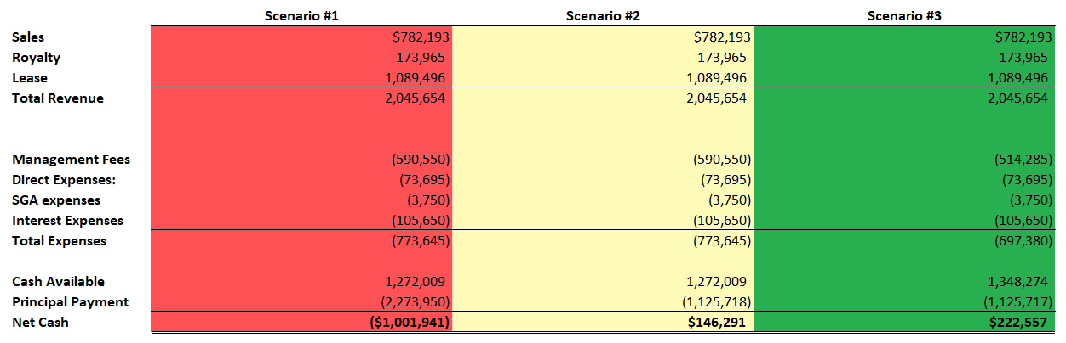
Notes:
This spreadsheet is colored to some calculation under 3 different scenarios. The entire scenario is colored, but notice the numbers in each column are the same. There are only a few numbers that are different, most importantly the final net cash numbers which is what should be highlighted to the reader.

Slide 9

Flag of Mali
Notes:
A good rule for you is, don’t make your chart look like the flag of Mali.

Slide 10
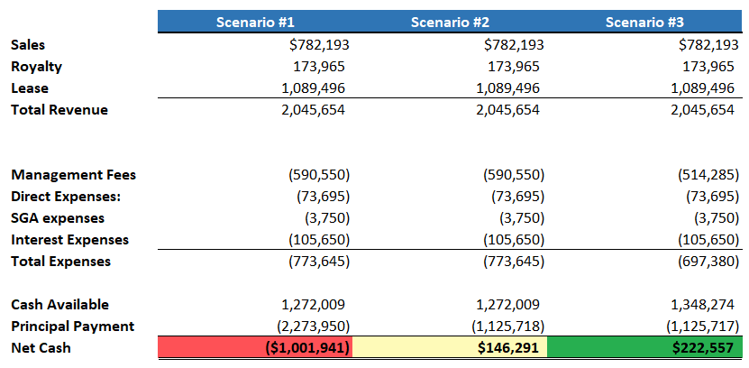
Notes:
This is that same data reformatted slightly, but this time only highlighting the numbers that are important to the scenario. The font is still a bit hard to read here. Notice the dark text on the red and green are hard to read. If using a dark background color then the best contrast will be with the lightest font color and vice versa. When colors are in the middle of light and dark then a decision will have to be made as to what looks the best and provides the best contrast for the reader.

Slide 11
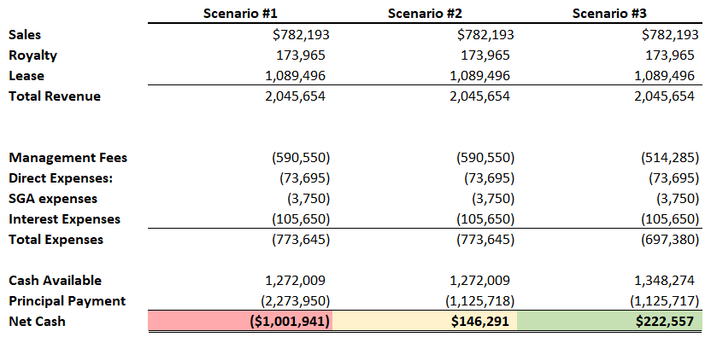
Notes:
By using light highlight colors, the text is easier to see. While this is not colorblind friendly, by having the numbers listed in the cell there is an accommodation for readers who have color vision deficiency.

Slide 12
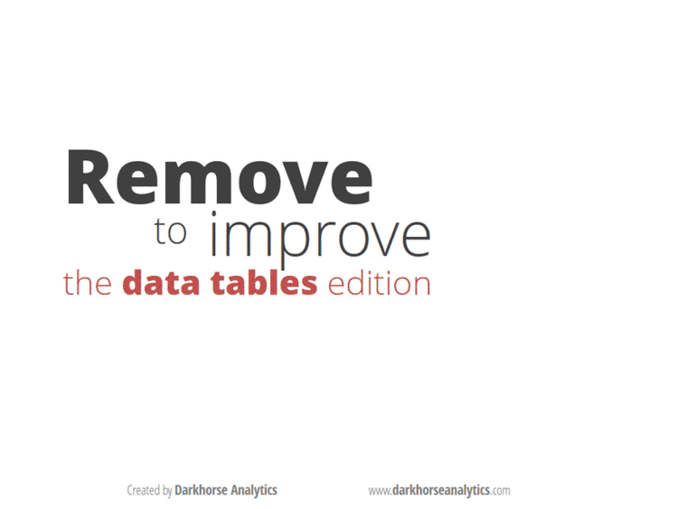
Notes:
[Animated GIF by darkhorseanalytics.com]

Slide 13
Real-World Example
Highlight Table

Slide 14
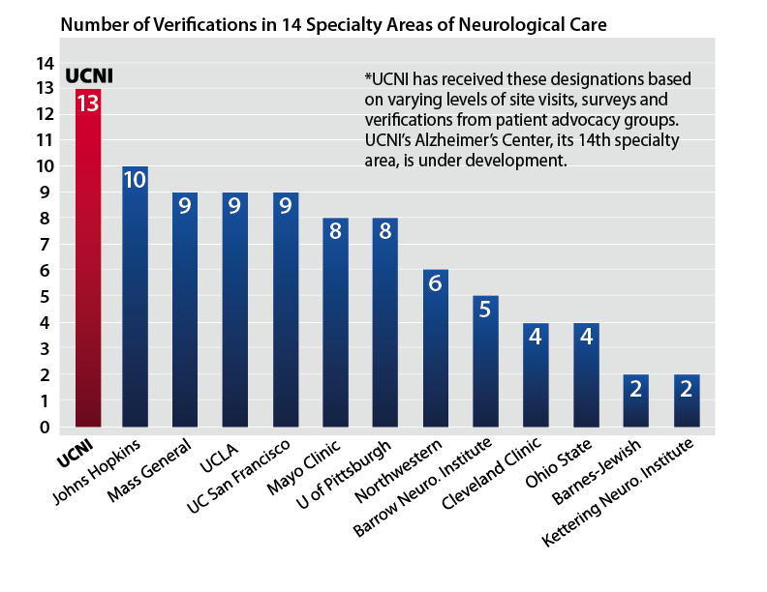
Notes:
This is a chart that was created by the University of Cincinnati Neurological Institute and was featured on their website. It shows that UCNI has 13 verifications in 14 specialty areas, making them the top position. Let’s see if we can make this data a little easier to read with a few minor improvements.

Slide 15
Notes:
The rotated text makes it very difficult to line up with the bar. There has been research about rotating text, showing that it takes longer for people to read and with higher inaccuracy. In this case, we see the text of UC San Francisco starting underneath Mass General which is two bars away on the right.
In addition, the y-axis is in units of 1, showing and approximation of where the 13 bars are, but then we have 13 labels giving them their exact position. The “footnote” with an asterisk is promonately placed at the top of the viz and the white gridelines are interfering with the text. The gradient color doesn’t add any value here.

Slide 16
Make horizontal
Horizontal text
Remove Axis labels
Fix gridlines on top of paragraph
Used ColorPic
Notes:
First we’ll rotate this chart to make horizontal bars with horizontal text. Then we’ll remove the axis labels and we’ll fix the gridlines. To get the red that is associated with the University of Cincinnati and the blue that is used in the chart, we will use a tool called Colorpic. Tools like Excel, PowerPoint and Tableau have a built in screen color picker tool, but you may still find this tool useful.
[Demo Colorpic for PC or ColorPicker for Mac]
Colorpic is a free download for PC. You can create your own color palettes. Open the program and select a color from anywhere on the screen. Hit CTRL-G to grab the color and you can save them to whatever palette name you like. You now can save various color palettes for use later. Once you have a color grabbed, it will show you the HSV, RGB and Hex color codes for that color. There is also a Copy to Clipboard function for the Hex color code, which will allow you to copy it and paste it into your programs like Tableau or Adobe.

Slide 17
Notes:
Here the first version. The bars and text are rotated and the footnote has been moved to the bottom, but we can do more. We still have gridlines in increments of 1.

Slide 18
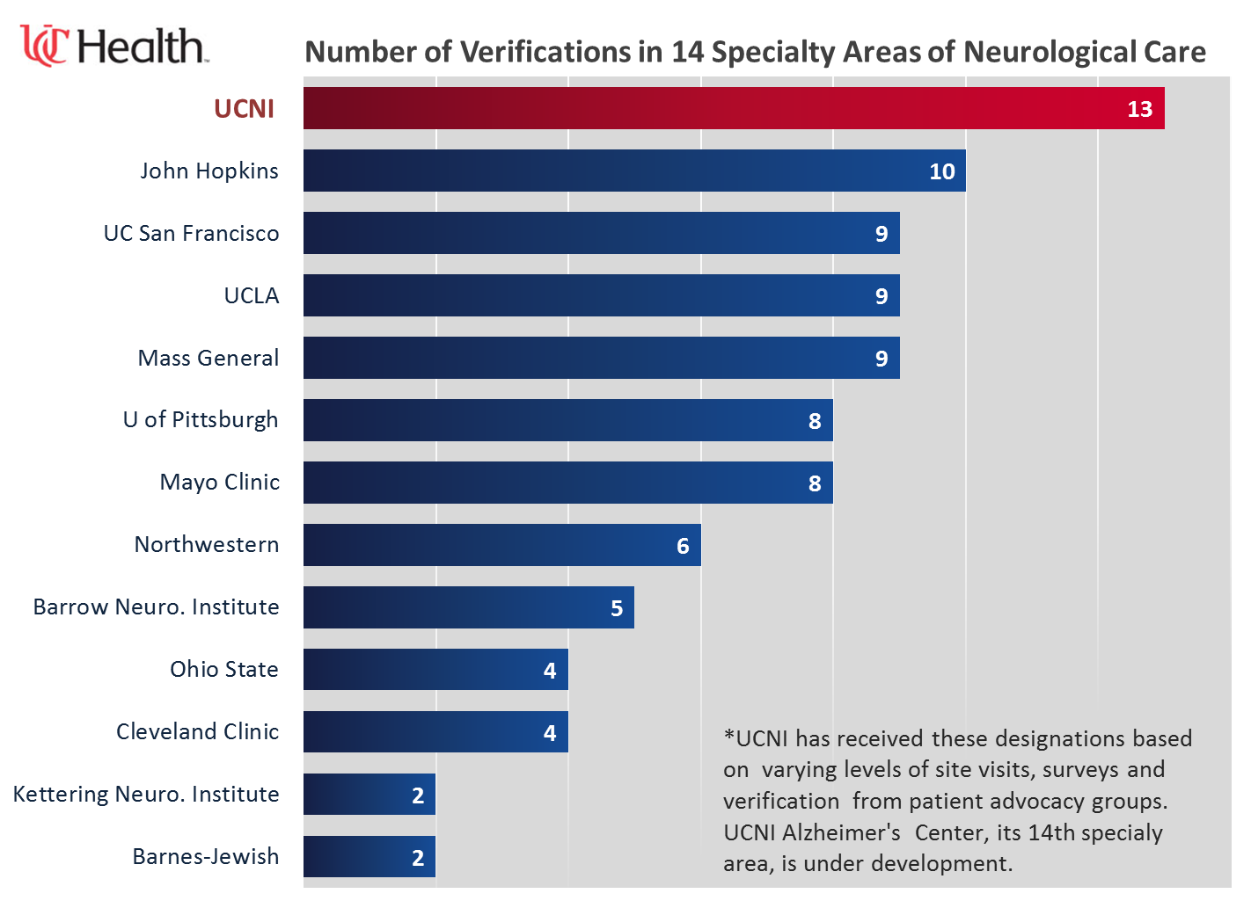
Notes:
This one spaces the gridlines to 2. In addition, there is now a logo on the top and the UCNI red to match the bar color. We still have gradient colors and a gray background that is not needed.

Slide 19
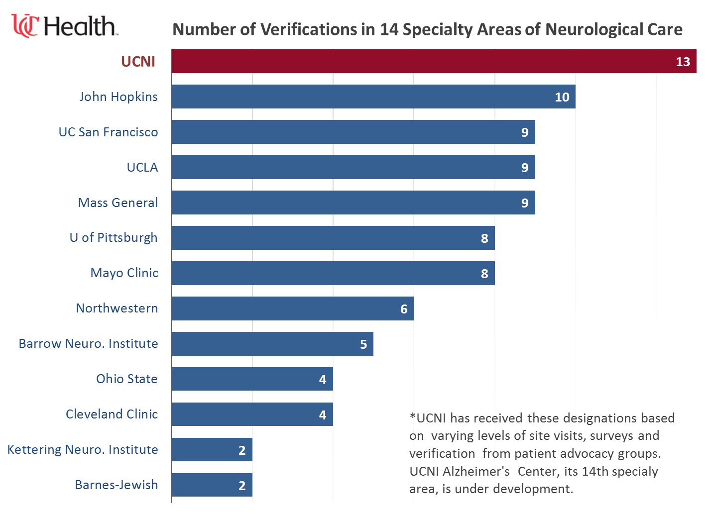
Notes:
In the final version, the gradient color has been removed from the bars as well as the gray background. This version is now much cleaner and easier to read.

Slide 20
Real-World Example
Sales Comparison

Slide 21
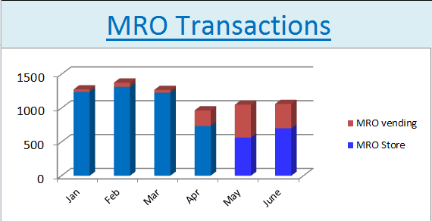
Notes:
This graph is comparing Vending transactions to Store transactions. There’s a number problems with this one.
[Class Discussion]
What problems do you see with this chart?

Slide 22
Design Issues
Title Format
Three Dimensional
Axis Labels on Angle
Dark Gridelines
No Data
Can’t easily compare
Color Choice
Legend Space
Notes:
This graph is comparing Vending transactions to Store transactions. There’s a number problems with this one. Especially the 3D effect and the difficult comparison of using a stacked bar chart.

Slide 23
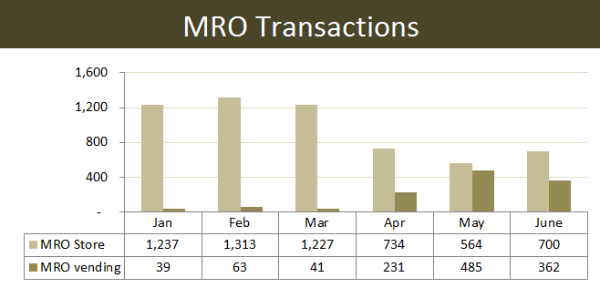
Notes:
Here is a redesign of that data using Microsoft Excel. The side by side comparison now makes it easy to see, especially the growth of Vending, which we could not easily see before.

Slide 24
Real-World Example
Technology Proficiency

Slide 25
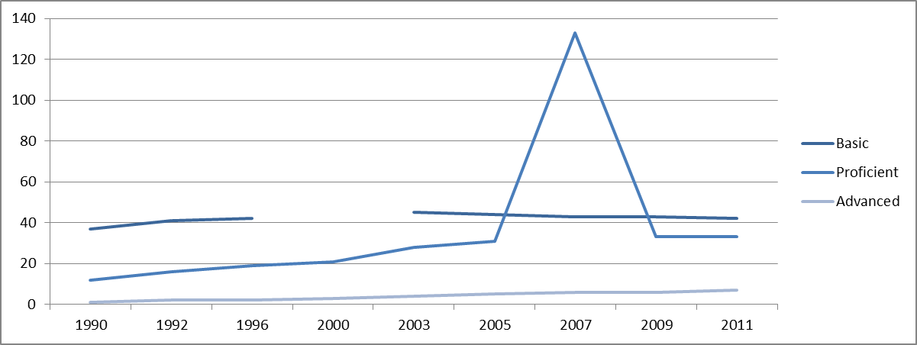
Technology Proficiency Over Time
Notes:
This data shows technology proficiency of employees at a company over time. What are the problems with this one?
[class discussion]
Unequal time scales
Bad data point (133 appears to be a data entry error)
There is a missing value for 2000
The color of the blues is very close, especially the two darker blues

Slide 26
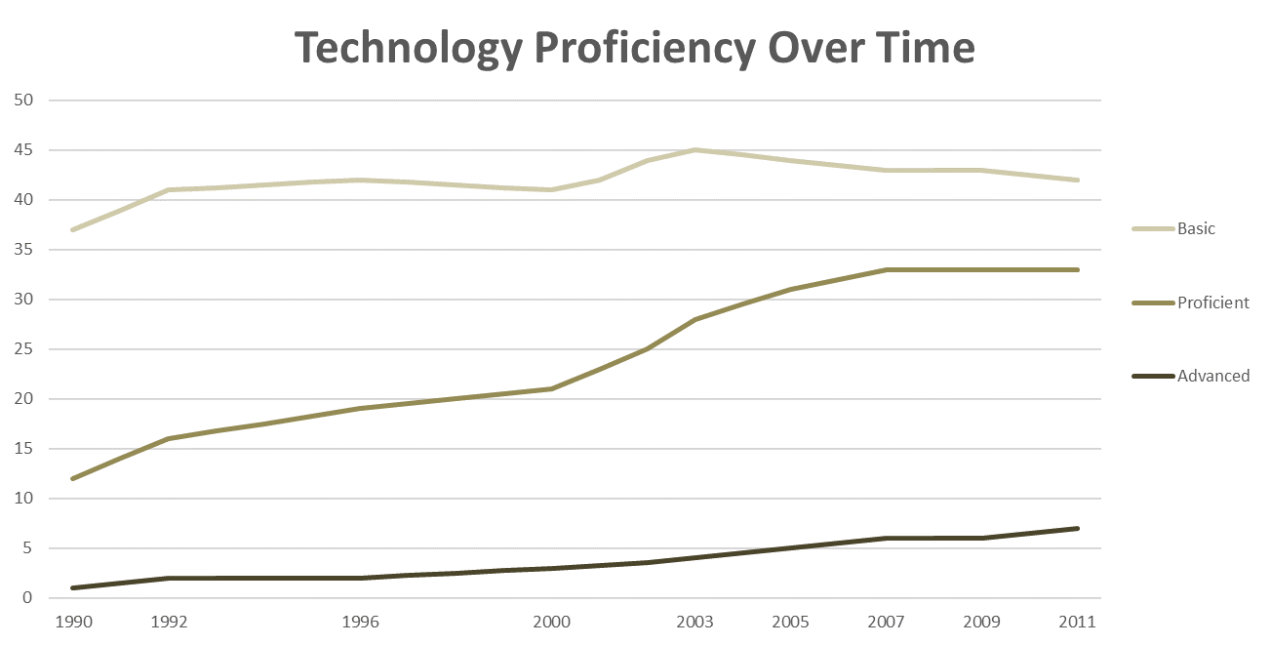
Notes:
This version solves for some of these issues, but it’s still hard to compare the data. Especially since the advanced proficiency is on a much smaller scale than the others.

Slide 27
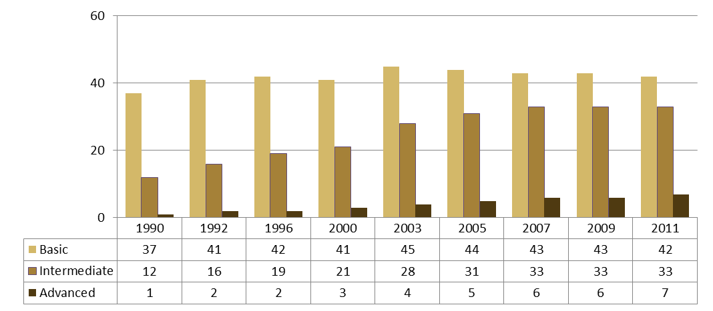
Technology Proficiency Over Time
Notes:
We could plot this in the same way we did the Vending vs. Store sales, this helps the uneven time scale, but in this case this design doesn’t work as well. Again, the scales are very different for basic, intermediate and advanced. It’s also hard to see the trends of each of them against each other.
[Optional Class Exercise]
This could be an optional class exercise asking the students to sketch better ways to visualize this data.

Slide 28
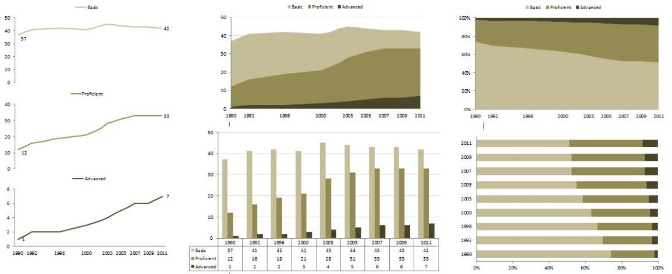
Technology Proficiency Over Time
Notes:
This dashboard attempts to put the pieces together in a redesign to solve for some of the issues. The line charts on the left hand side show the trend over time for each category very well, plotted on different scales so that you can now see the trend of each category. The other charts try to show various comparisons to compare the overall technology increase, but there are better ways we can show this.

Slide 29
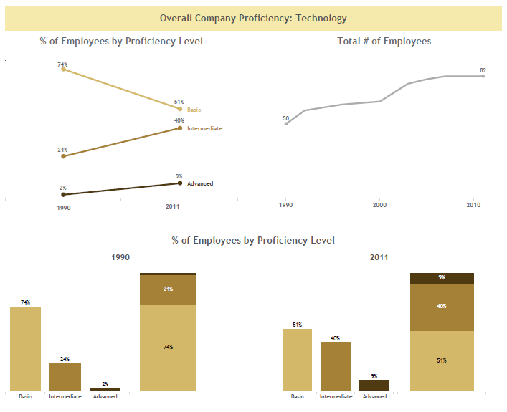
Notes:
This example focuses on two time periods and ignores the rest of the years. A Slopegraph is used to show the percentage of student at each proficiency level (converted to a % from the absolute numbers). The bar charts and stacked bars at the bottom show the distribution for those two time periods. The other interesting view here is the total # of employees that has been calculated and plotted on a line chart. This is the first view that we’ve seen of this data showing the growth of the company from 50 employees to 82.

Slide 30
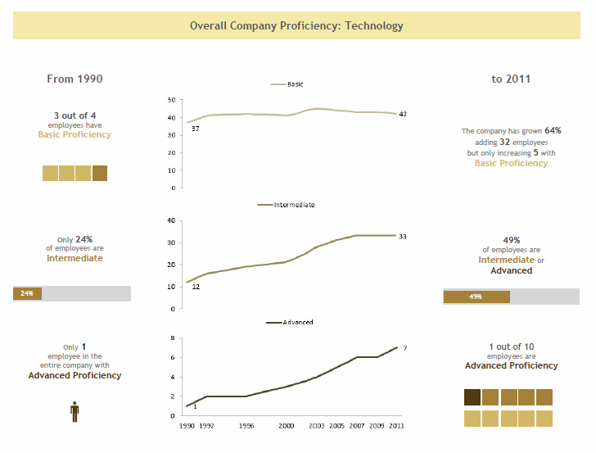
Notes:
This visualization also focuses on the two time periods. The line charts that we saw before showing the trend for each level of proficiency. The message has been spelled out more on this one. “In 1990 only 24% of the employees were at the Intermediate level of proficiency and only one single employee was advanced. In 2011, nearly half of the company was Intermediate or Advanced and 1 out 10 in the company were advanced. These last few examples have provided lots of information that we didn’t have in the original view of the data.

Slide 31
Real-World Example
Comparing Vendors

Slide 32
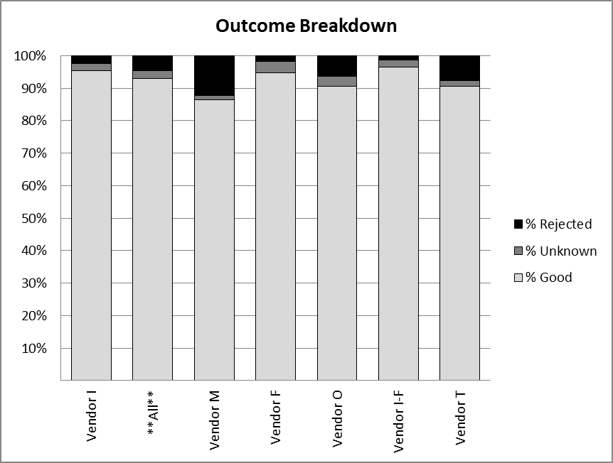
Notes:
This is a real chart that was created to compare vendors. There are 3 outcomes, Good, Rejected and Unknown. The vendors are shown on the x-axis along with an “All” category.

Slide 33
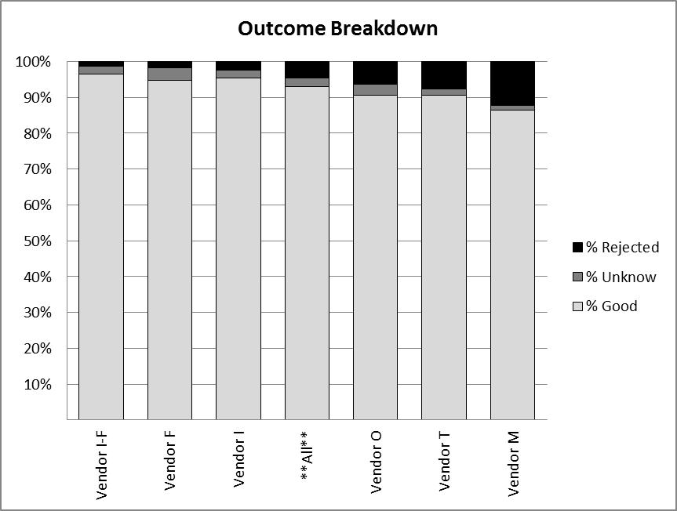
Notes:
We learned about the power of ordering the data and that helps a little. We can see that Vendor M has the highest rejection rate. The “All” is now in the middle because it’s the average of all of them. Let’s see what this data looks like when we unstack it.

Slide 34
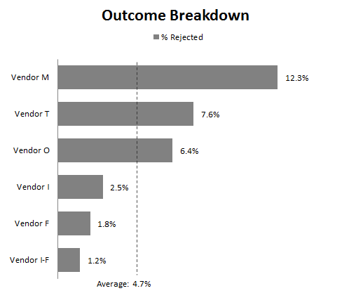
Notes:
Here are the Rejected Outcomes by vendor. The “All” bar has been converted to an Average Line so that we can now easily see the vendors above and below average and the rejected rate has been added as a label. Consider what we now know about this data. You can see the top 1 or 2 or 3 vendors, or the bottom 1 or 2. You can see how far away from the average each vendor is, below or above.

Slide 35
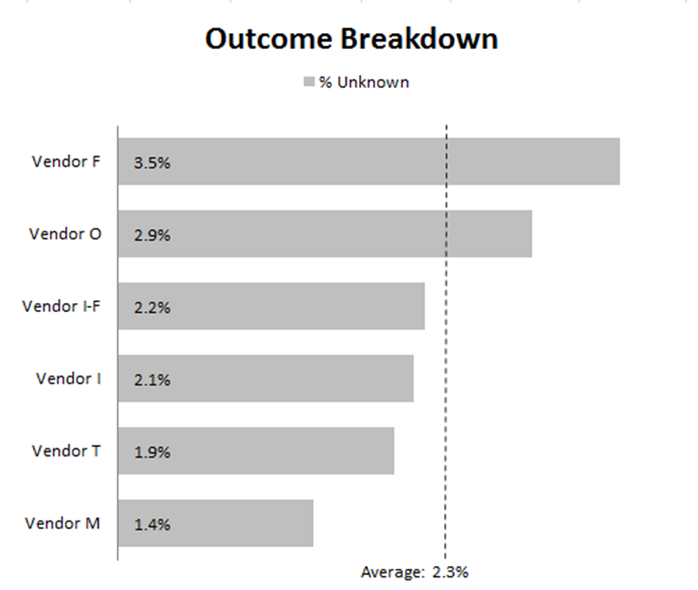
Notes:
Here’s the Unknown Outcomes plotted in the same format. We won’t plot the Good Outcomes, because we don’t need to see those, they’re “good”.

Slide 36

Notes:
Now we can put the charts together for a full view of our vendors. This provides even more insight. For example, we know Vendor M is the highest Rejection Rate, but they are also the lowest Unknown outcomes. Vendor F that is 2nd from the bottom on rejects is actually at the top of the list for Unknown outcomes. While Vendor M has the highest rejection rate, at least it’s clear what the outcome is. Vendor F might in fact be a bigger problem with the highest percentage of Unknown outcomes that may require intervention to resolve as Good or Rejected.
This view is good if you are interested in answering questions about the Rejected or Unknown vendors. For example, what are the top 3 vendors with the highest rejection rate? And the bottom 3? How about the unknown rate? What are the top 3? And the bottom 3?
However, notice that the order does not match across the charts? They are both ordered by the highest rates within their category. This makes is a little harder to answer questions about a specific vendor.

Slide 37
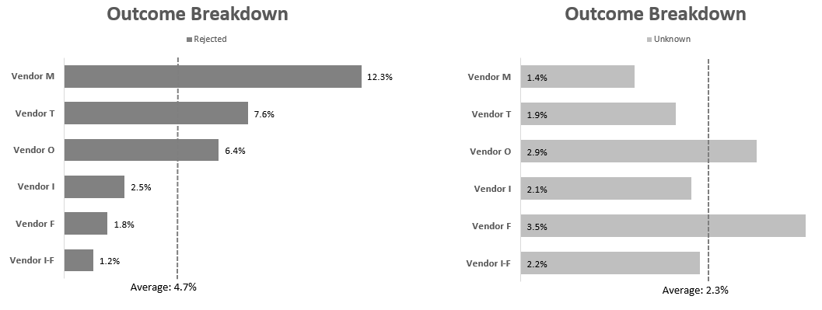
Notes:
In this example, the vendors are ordered by the rejection rate, even on the chart of unknown outcomes. Now it’s easy to see where a vendor lines up across the chart, but now it’s harder to answer questions about the unknown rate.
One more thing that might be confusing to the reader is the independent scales of the two bar charts. The 3.5% of the unknown is as long as the 12.3% of the rejected rates.

Slide 38
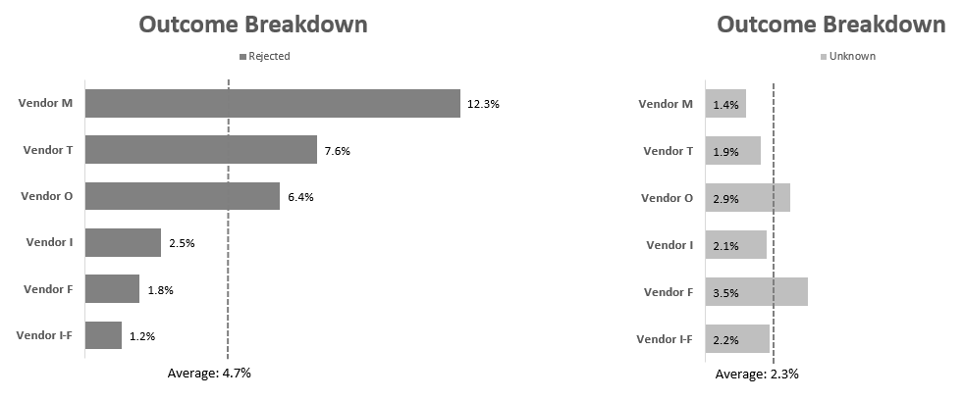

Slide 39
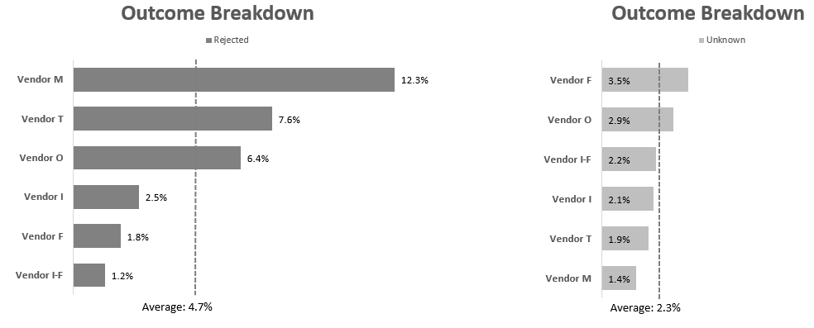
Notes:
And here is that same scale sorted within each outcome category.

Slide 40
Bar Chart Issue

Slide 41
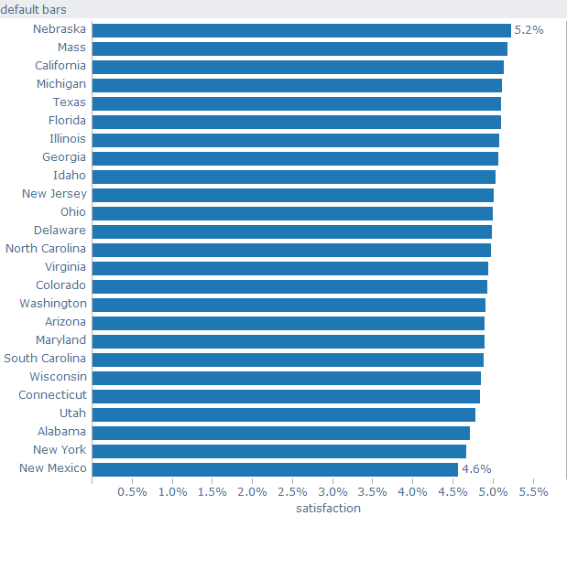
Notes:
Bar charts are great, but they are not without their issues. In this case, look at all the bars representing the satisfaction rate of something by State. Notice that there is a bit of a Moiré effect. The lines begin to shimmer on us. It’s a very busy and distracting view. Also, the range of the data is very small. The bottom end of 4.6% going to the top end of 5.2%.

Slide 42
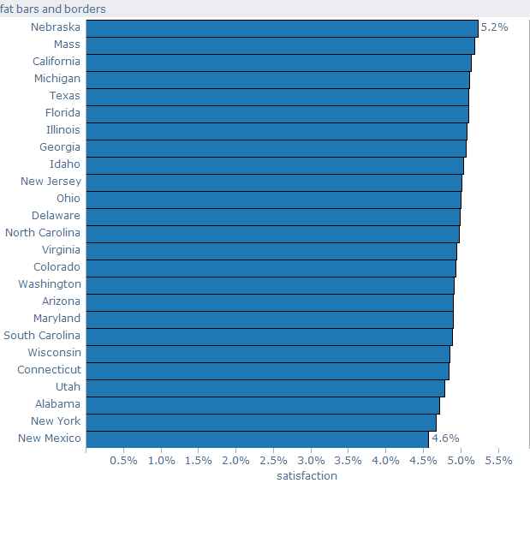
Notes:
We could try to close the gap, but this doesn’t solve much. It’s just a big blob of blue.

Slide 43
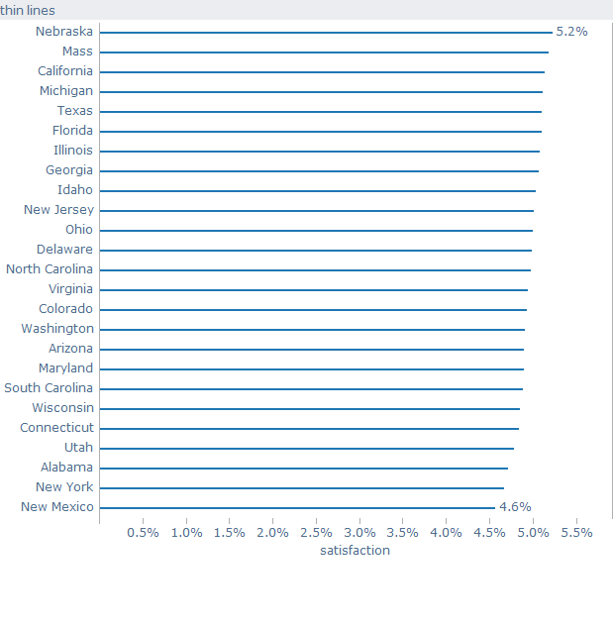
Notes:
We could make very thin lines, but then it’s hard to see where the points end. So what solutions can you think of?
[class discussion]
Starting the axis at a different number than zero – we can’t do this on bar charts because they are encoding the length of the bar.
Scatter plot – this shows two measures on the two axis. In this case we only have one measure and a dimension
A shaded map could work, coloring the States by satisfaction rates, but the color shade would be important due to the narrow range of the data.
Diverge the data from an average line – this is an elegant solution and could be done with bars, dots or lollipop chart
Dots could be a good solution, which will be discussed

Slide 44
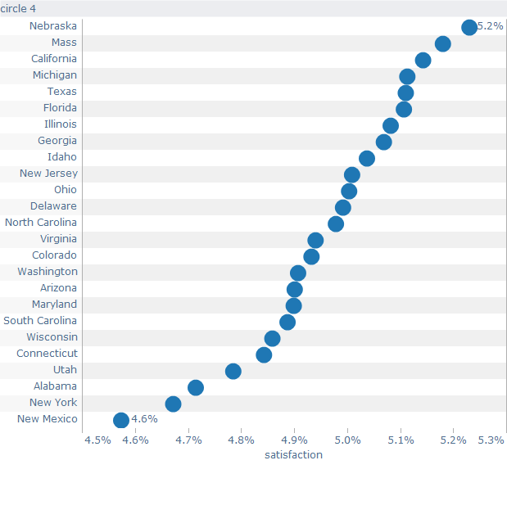
Notes:
Using dots works and we can adjust the axis on these so that it doesn’t start at zero. In this case, we start it at 4.5% and we can see the little differences between the points.

Slide 45
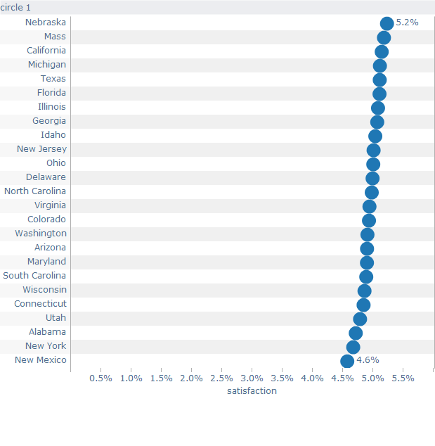
Notes:
Keeping the axis at zero would work too, but then there is lots of space between the State names and the dots.

Slide 46
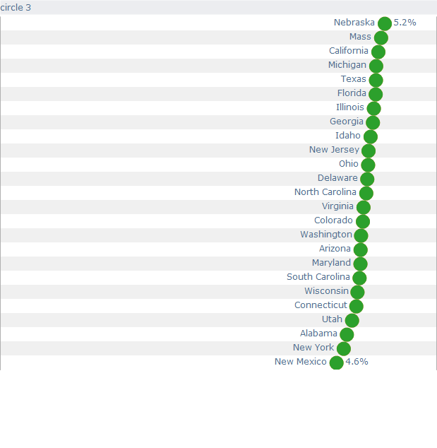
Notes:
We could move the dots next to the labels and then we have a pretty concise view. The empty areas on the left can now go away.

Slide 47
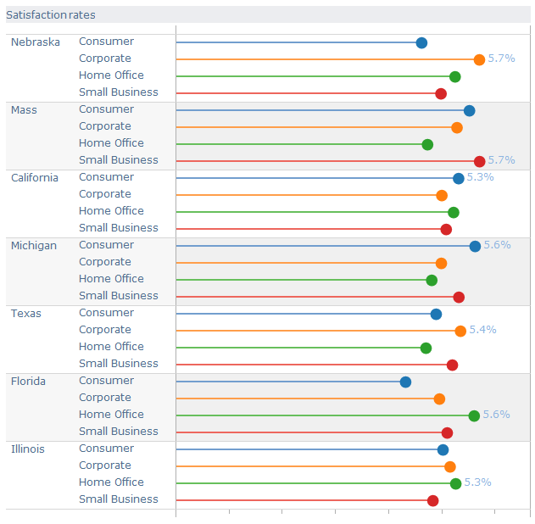
Notes:
Another chart type that might work in this situation is the lollipop chart. The term “lollipop chart” was coined by Andy Cotgreave, one of the co-authors of The Big Book of Dashboards. It offers the same encoding as a bar chart, using length to encode the data, but the bars are very thin and therefore don’t create the Moiré effect when viewing the chart. The dots also provide a clear end point, acting in the same manner as a dot plot.

Slide 48
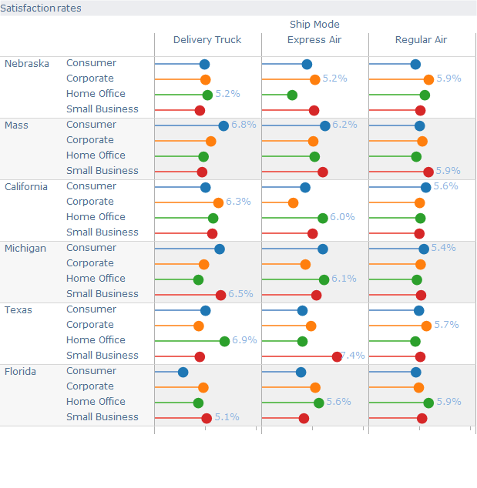
Notes:
This example is packed full of data, yet it doesn’t look as busy as a bar chart would. This is showing Satisfaction rates by State, Category and Delivery Method. Notice that only the highest value in each section has been labeled to avoid additional clutter of adding labels to every dot.

Slide 49
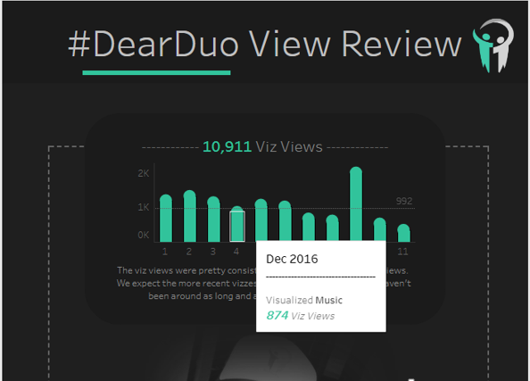
Notes:
One word of caution on lollipop charts. The value that is interpreted could be perceived to go from the baseline up the line to the top of the dot on the lollipop. This could distort the value because the true value is the center of the lollipop.
As an example, here is a rounded bar chart that was created by Adam Crahen and Pooja Gandi from the Data Duo. The value for the selected bar is 874, but because there is a dot on the top of the bar, it extends past the 992 reference line an up to 1,000. They ended up changing this viz to simply use bar charts.

Slide 50
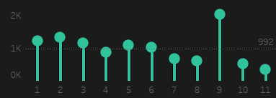
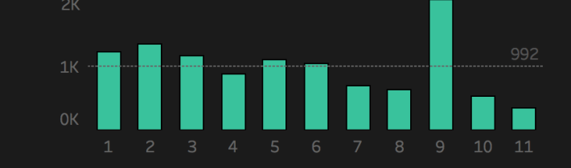
Notes:
Notice the lollipop makes it appear that number 4 is above the reference line, when in fact it’s below.

Slide 51
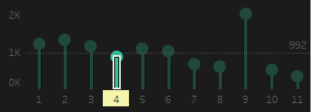
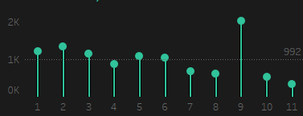
Notes:
Because of this issue, some in the data visualization community advise against lollipop charts, for example, Stephen Few has written about this and recommends not using them at all. Others, like Alberto Cairo and Jeff Shaffer have argued that if the circles are not too big then they can work well, especially when values are labelled next to the circles providing the exact values.
Note – there is no known research to date in this area, specifically relating to lollipop charts.

Slide 52
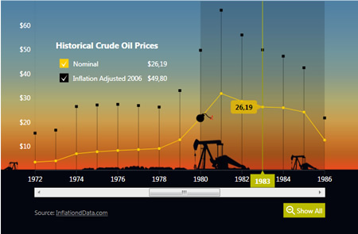
Notes:
This example is another interesting use of a lollipop to avoid clutter. A line chart showing the Nominal Price of Crude Oil over time. The black lollipop then shows Inflation Adjusted to 2006. The thin line of the lollipop in this case doesn’t distract from the overall design, where a black bar chart would have dominated the view.

Slide 53
A Problem with Scale
An Example from The Big Book of Dashboard

Slide 54
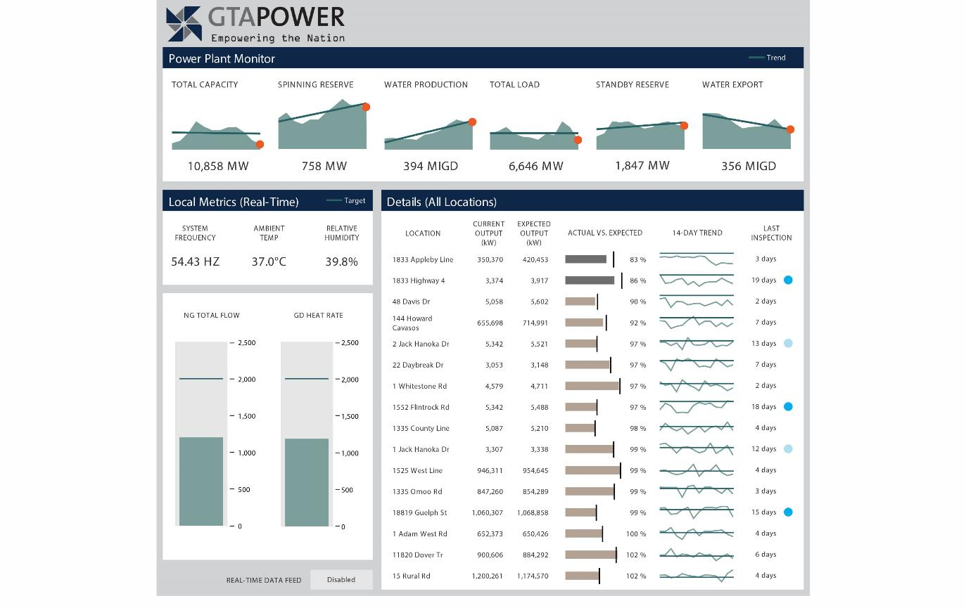
Notes:
This is the GTA Power dashboard from The Big Book of Dashboards. Notice the bar charts with target lines showing actual vs. expected.

Slide 55
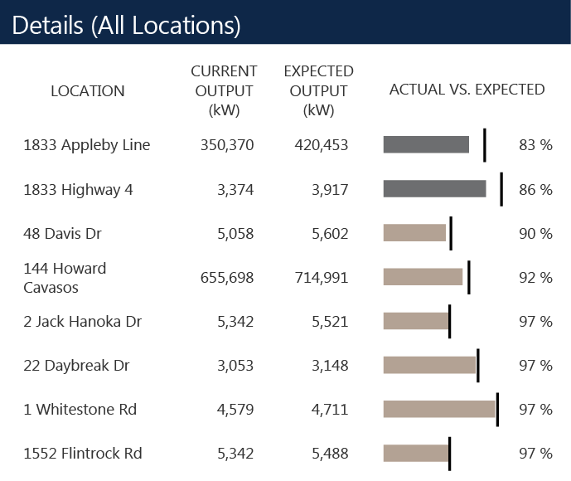
Source: The Big Book of Dashboards (Figure 9.9)
Notes:
The original designer of this dashboard at Dundas Data Visualization used a different scale of each of these bars. This creates a visualization that makes it impossible to see scale, only the current vs. expected comparison. For example, the first power plant has an expected output of 420,453 and the second one is only 3,917. These two plants are on a completely different scale, but the bar on the second line is bigger than the first line. This could be very confusing for a reader. But solving this isn’t an easy task.

Slide 56
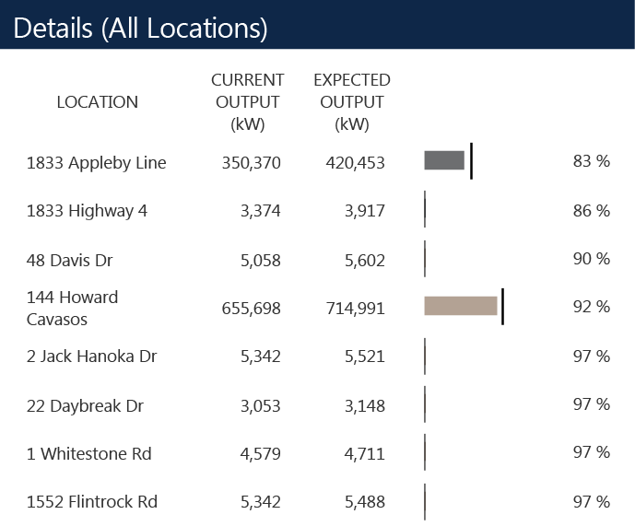
Source: The Big Book of Dashboards (Figure 9.10)
Notes:
Here’s the same data where all of the bars are plotted on the same scale. Notice here that we can only see the values now for the two largest power plants. Every other power plant is at or near zero, so the bars and target lines for those are now useless.

Slide 57
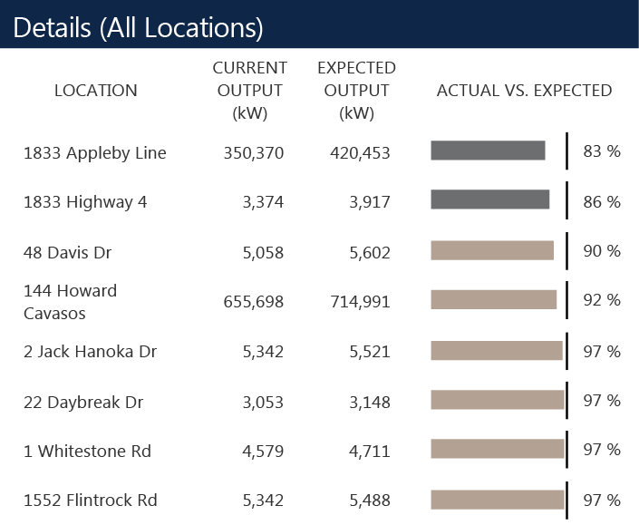
Source: The Big Book of Dashboards (Figure 9.11)
Notes:
This could be converted to a % of expected output, so that they can be plotted evenly on the same scale. This could be a useful view if the user just wanted to know which plants were on target for the expected output. The manager 22 Daybreak Dr. can see that his or her plant is at 97% of expected output. That may be the measurement that they are measured against, so this could be a very import KPI. However, this does not show what the biggest impact is across all plants. The plant at 144 Howard Cavasos is at 92% of expected output, but it’s contributing 60,000 kW to the shortage of expected output. So how can we show both the current to expected output as well as the magnitude of their power production?

Slide 58
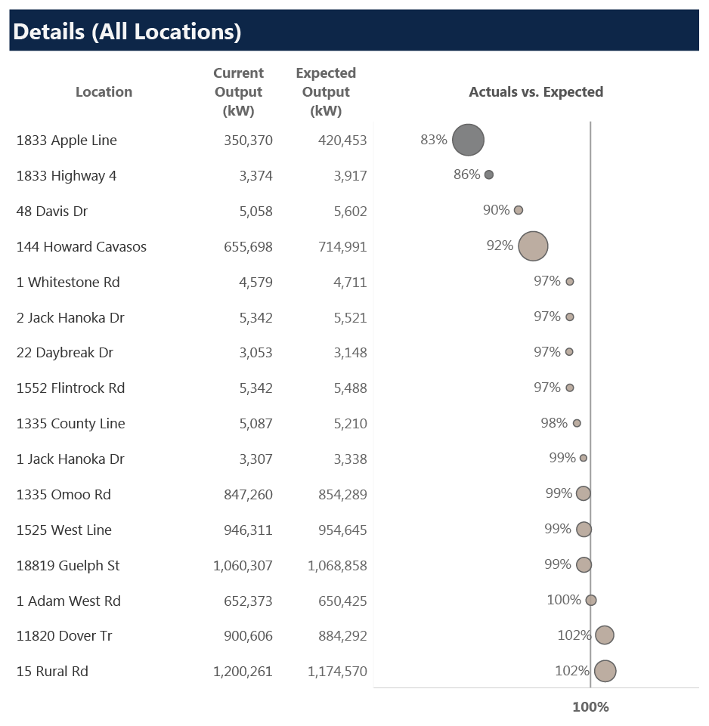
Source: The Big Book of Dashboards (Figure 9.12)
Notes:
This view shows both. Using a target line at 100% for every plant, we can see where each plant is against its target. The size of the circle shows the magnitude of the output, either below target or above target.

Slide 59
Real-World Example
Kroger Investor Fact Book

Slide 60
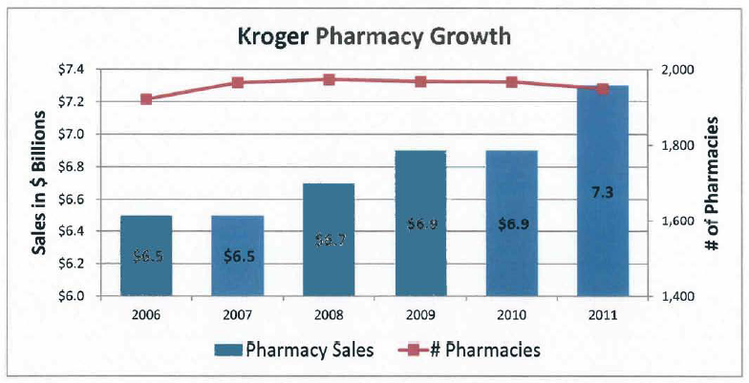
Source: 2011 Kroger Fact Book – Page 29
Notes:
This next example comes from Kroger, which is the third largest retailer in the world behind Walmart and Costco. This chart is published in their annual Fact Book. The title states “Kroger Pharmacy Growth”. The blue bar shows pharmacy sales and the red line is the number of pharmacies. So what’s the issue with this one?
[class discussion]
The students might focus on design issues, ex. The color of the blue bars or the rotated text. This is good, but then try to focus them on the data.
The bar chart does not start at zero, so the $6.5 billion looks like it doubles to $6.9 billion and then triples to $7.3 billion. That’s clearly wrong and drastically distorts the view of this data.
The line chart also doesn’t start at zero, but that’s ok for a line chart. What’s not clear here is the “Pharmacy Growth”. They must mean Sales, because it’s not the number of pharmacies on the line chart.
Note:
This chart is dated as 2011, but unfortunately, Kroger continues to publish this chart year after year.
Source: http://ir.kroger.com/
http://ir.kroger.com/Cache/1500100492.PDF

Slide 61
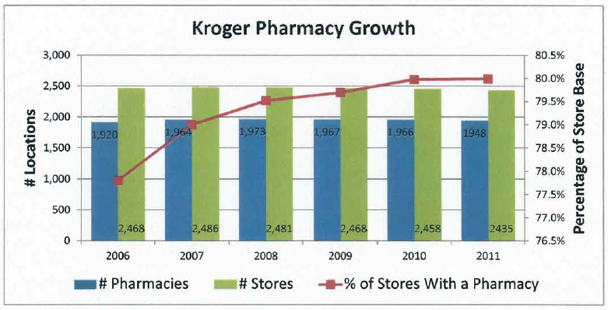
Source: 2011 Kroger Fact Book – Page 29
Notes:
This chart is also included which allows us to see the actual numbers for the stores and pharmacies. In this chart, the bar start at zero. The blue bars represent the total number of pharmacies and the green bar shows the total number of stores. The red line represents the number of pharmacies divided by the total number of stores or blue divided by green. “Pharmacy Growth” on this chart mush mean the growth in the % of Stores with a Pharmacy. But notice the secondary y-axis. The range of the data here is from 78% to 80% and they chose to start this one at 76.5%. So let’s look at the data.

Slide 62
Kroger Pharmacy Growth?
What the data actually shows:
Notes:
Two points have been highlighted, 2007 and 2001. Pharmacies went from 1,964 up to 1,973 and dropped each year down to 1,948, almost back to 2006 levels.
Ok, now let’s look at the stores. The total stores peaked at 2,486 stores and then has dropped each year down to 2,435, which is lower that 2006 levels.

Slide 63
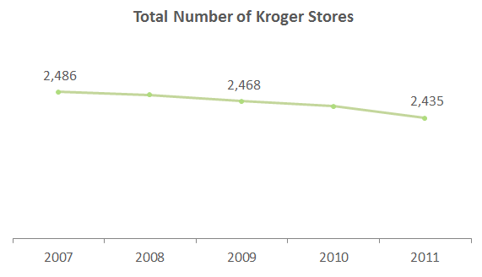
The Real Story
Notes:
So the total number of stores has dropped.

Slide 64
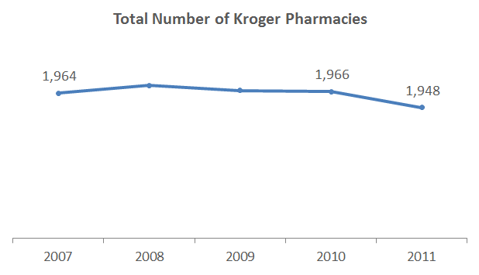
The Real Story
Notes:
And the total number of pharmacies grew and then dropped.

Slide 65
Source: 2011 Kroger Fact Book – Page 29
Notes:
So if the total number of pharmacies has dropped and the total number of stores has dropped, then how is the % of stores with pharmacies going up?
[class discussion]
- The answer is that they are closing stores without pharmacies.

Slide 66
What is the real message?
From 2007 to 2010 Kroger closed stores that don’t have pharmacies thus increasing the % of stores with a pharmacy.
Kroger has increased Pharmacy Sales from $6.5B to $7.3B with fewer stores and fewer pharmacies
They missed a very compelling Story
12% increase in Sales with Lower Costs!
Notes:
So Kroger has missed a very compelling message here. From 2007 to 2010 Kroger closed stores that don’t have pharmacies. Kroger has actually increased Sales from $6.5B to $7.3B with fewer stores and fewer pharmacies. This is a really compelling story. They have achieved a 12% increase in Sales and they did it with lower costs.

Slide 67
Just for Fun
OkCupid

Slide 68
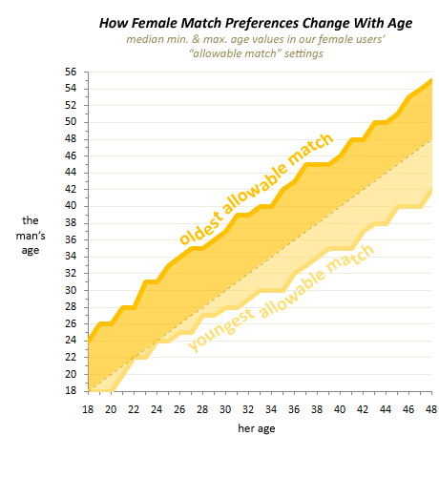
Notes:
This next example comes from OkCupid. OkCupid was founded by some mathematicians and later bought by Match.com. OkCupid tracks lots of information on their website and they write about it on their blog. When a user signs up for OkCupid they enter their age and then they also enter the preferred range for a match. This chart plots a females age as the dotted line. The yellow bands show the range above and below her age that she is willing to data. We see slightly higher range older versus the narrower range that is younger. OkCupid also tracks who messages each other in their system and so they decided to compare that to the match preference.

Slide 69
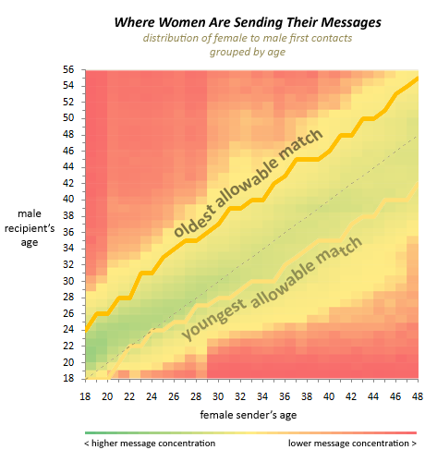
Notes:
We see here they green and yellow areas where they message more in the system and the red area where they don’t. Women tend to message near there range, but a little wider on the younger end than the match preference they originally entered into the system.
Now let’s look at men.

Slide 70
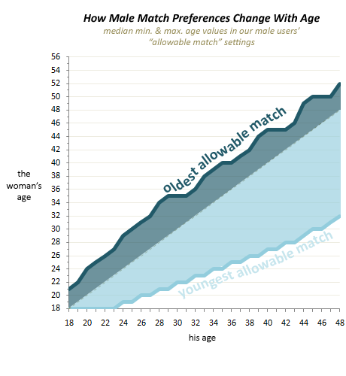
Notes:
Here’s the match preference for me. As we can see, the men are much more willing to date a women that is younger, especially as the men get older. We see a 48 year old man willing to date a 32 year old woman. Now let’s see who they message.

Slide 71

Notes:
They pretty much message anyone younger than them. The older range stay pretty tight to their match preference, but in this case we have 48 year old men messaging 24 year old women.

Slide 72
“Don’t be Ugly By Accident!”
OkCupid (blog.okcupid.com)
Collected 552,000 examples of users pictures
Asked people to rate their attractiveness
Compared with the data from the camera
Notes:
They also collected lots of data around the profile picture that were submitted to the website. They collected over a half a million user pictures and they asked people to look at the picture and rate the user’s attractiveness simply based on their profile picture. Then they compared that data to the data that is capture on the camera when the picture was taken, basically the meta data that is stored by the camera for each picture.

Slide 73

Source: OkCupid (blog.okcupid.com)
Notes:
First they looked the type of camera. The photo attractiveness is on the y-axis. The interchangeable lens did the best, with many of the SLR cameras providing a more attractive picture. Camera Phones were at the bottom of the list, making the picture much more unattractive.
This chart works pretty well, but another great example of rotated labels that could easily have been avoided by simply rotating the chart.

Slide 74
Source: OkCupid (blog.okcupid.com)
Notes:
First they looked the type of camera. The photo attractiveness is on the y-axis. The interchangeable lens did the best, with many of the SLR cameras providing a more attractive picture. Camera Phones were at the bottom of the list, making the picture much more unattractive.

Slide 75

Source: OkCupid (blog.okcupid.com)
Notes:
They looked at that same data throughout the age of the user. Based on this data someone who is 32 taking their picture with a camera phone has the same attractiveness rating as a 45 year old using an interchangeable lens. As we age, the type of camera becomes less of a factor.

Slide 76

Source: OkCupid (blog.okcupid.com)
Notes:
They also looked at the use of Flash vs. No Flash. Using a Flash appears to take 8-10 years of your life on the scale of attractiveness.

Slide 77

Source: OkCupid (blog.okcupid.com)
Notes:
Then they looked at the time of day. “Peak attractiveness” appears to be 6:30am and 5pm. The low points seem to be 2am, 10am and 8pm.

Slide 78

Source: OkCupid (blog.okcupid.com)
Notes:
They plotted these peaks along with the sunrise and sunset. The best times to take a picture seems line up when the sun is at the horizon.

Slide 79
What did we learn from OkCupid?
Take your profile picture with an SLR camera without the flash at 6:30am or 5pm for your best chance of being considered attractive.
Notes:
What did we learn from OkCupid? For those of you who might be trying to find that perfect match, make sure to take your profile picture with an SLR camera, without a flash at 6:30am or 5pm for your best chance of being considered peak attractive.

Slide 80
Real-World Example
Hamilton County vs. Auditor’s Office

Slide 81


Notes:
These charts were created by the Hamilton County Auditor’s Office in Cincinnati, Ohio. They plotted the “red team” which is all of the employees who work for Hamilton County against the “blue team” which is their office.

Slide 82



Notes:
Here’s a close up of part of the charts. So what are the issues with this one?
[class discussion]
The y-axis does not start at zero causing the comparison of the data to be drastically distorted.
3D effect on the bar chart
Over labeled

Slide 83


Notes:
This is time series data, so often times a line chart is best to show this type of data over time. And this does a good job of showing the trend for each of them, but what the “blue team” was trying to do is to compare themselves to the ‘red team”. So it would be better if we could compare the two of them together some how. In many of the previous example we broke a stacked bar or line chart apart into individual bars or lines. In this case, let’s see what it looks like if we put these two lines together on the same chart.

Slide 84

Notes:
Now there’s two ways we could have done that. We could show the numbers as a %, with each office starting at 100% and then calculating above or below the 100% mark. The other way is to line them up using a dual-axis. In this case, then red team is on the left y-axis and the blue team is on the right y-axis. The scale is lined up so that at the starting point in 1990, the starting values match the same position. A dotted line has been added to show that starting position and then we are off to the races for 21 year. We can easily see that the red line grows and stays at a really high level until 2008, the financial crisis, and then it falls dramatically, but only falling below the 1990 levels in 2010.
Meanwhile, the blue team has constantly reduced staff from 1990 to 2011.

Slide 85
Exercise:
Notes:
Let’s try an exercise.

Slide 86
Hamilton County has hired you to create an alternative graph to argue the Auditor’s Position.
Can you use this same data to tell a completely different story?
Using the same data, design an alternative version for Hamilton County that tells a better looking story for them.
Notes:
The red team, Hamilton County, has now seen this new chart, and they want to hire you to create a chart for them to tell their story. Using this same data, can you design an alternative version for the red team that tells a better story for them to use against the blue team.

Slide 87
Notes:
[class discussion or break into groups for 5 minutes to discuss options – either works well]

Slide 88
Alternative #1:
Use absolute # of employees instead of %
375 FTE vs. only 108 (nearly 3.5x more)
Graph total number reduced as comparison
Alternative #2:
Adjust time period
Maximizes reduction for Hamilton County
Since 2008 - 1,442 FTE reduced vs. only 13
Notes:
There are a number of options for this exercise, but focusing on the number of absolute employees and the time period are really interesting.

Slide 89
Notes:
Focusing on 2008 where the red team is at it’s peak and then begins to fall has the biggest impact and then calculating the number of employees.

Slide 90

Notes:
If we create the exact same chart with those two changes, we now see the red team starting at 6,080 employees and dropping to 4,638. They’ve reduced staff by 1,442 full-time employees while the auditors office has only reduced staff by 13 people. Just imagine the head of Hamilton County discussing this story. “I’ve only been in office for 4 year, so I’m not sure why the Auditor’s office is focusing on the last 21 years. In my time in office, look what I’ve done.”
This is the exact same data and both charts are correct. They just show a different time period and different calculation around the same story.

Slide 91

Notes:
We can understand a bit when we see politicians do this. This chart was likely created by the “blue team” to show how crazy the ‘red team’ is when discussing the top tax rates. Notice all the other presidents are sitting on top of the bars except Obama who is pushing up a much smaller bar.

Slide 92

Notes:
This one is surely the “red team” discussing the fact that the top 10 percent of earners paid 70% of all of the taxes.

